Slide 1
Introduction to Machine Learning
By Hackslash

Slide 2
Quick Questionnaire
How many people have heard about Machine Learning?
How many people know about Machine Learning?
How many people are using Machine Learning?

Slide 3
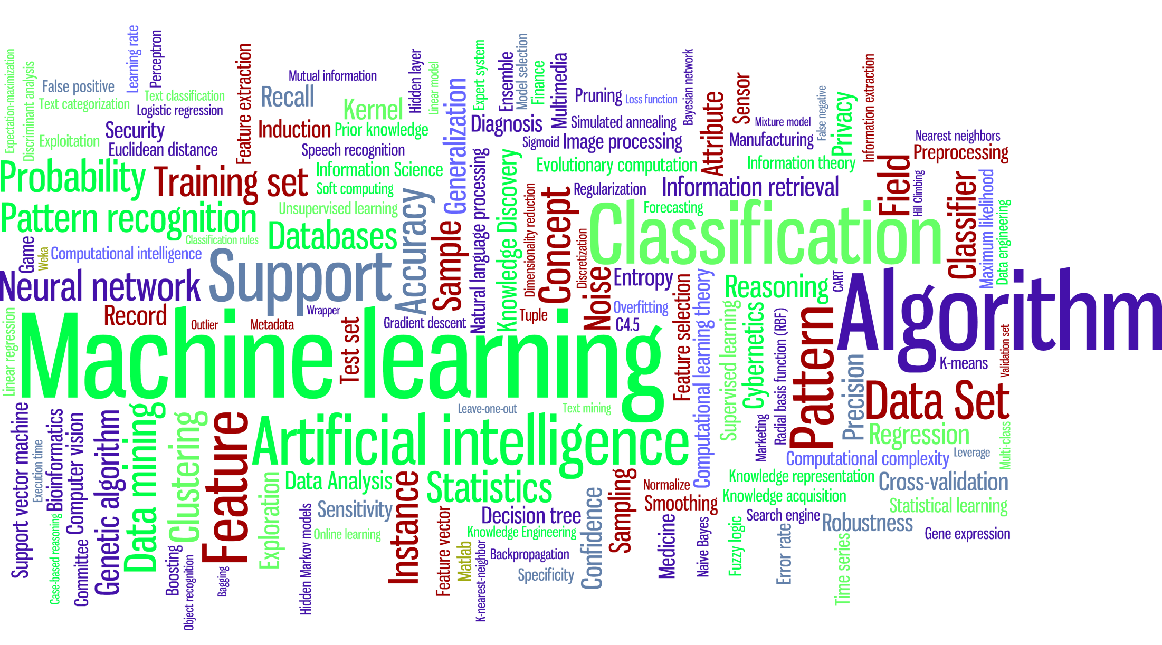

Slide 4
What is Machine Learning?
Arthur Samuel (1959). Machine Learning: Field of study that gives computers the ability to learn without being explicitly programmed.
Herbert Alexander Simon. “Learning is any process by which a system improves performance from experience.”
“Machine Learning is concerned with computer programs that automatically improve their performance through experience. “
Tom Mitchell (1998). Well-posed Learning Problem: A computer program is said to learn from experience E with respect to some task T and some performance measure P, if its performance on T, as measured by P, improves with experience E.

Slide 5
Why Machine Learning?
Develop systems that can automatically adapt and customize themselves to individual users.
Personalized news or mail filter.
Discover new knowledge from large databases (data mining).
Market basket analysis (e.g. diapers and beer).
Ability to mimic human and replace certain monotonous tasks - which require some intelligence.
like recognizing handwritten characters.
Develop systems that are too difficult/expensive to construct manually because they require specific detailed skills or knowledge tuned to a specific task (knowledge engineering bottleneck).

Slide 6
Why Now?
Flood of available data (especially with the advent of the Internet).
Increasing computational power.
Growing progress in available algorithms and theory developed by researchers.
Increasing support from industries.

Slide 7
Let’s see the usage in Real Life

Slide 8
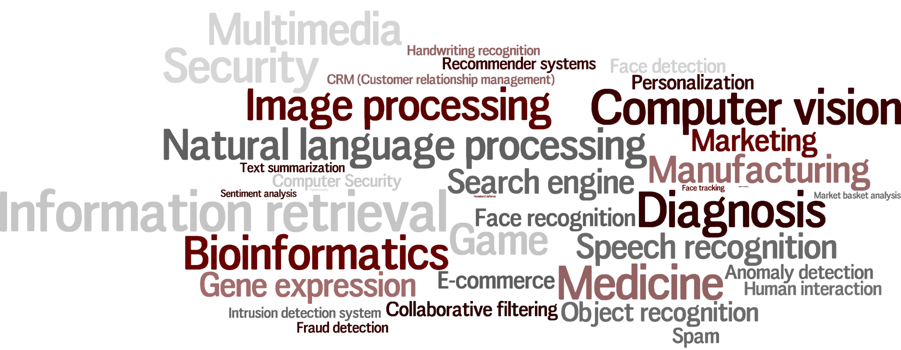
Machine Learning Applications

Slide 9
Machine Learning in Real Life
Spam Email Detection
Machine Translation (Language Translation)
Image Search (Similarity)
Clustering (KMeans) : Amazon Recommendations
Classification : Google News
continued…

Slide 10
Machine Learning in Real Life (contd.)
Text Summarization - Google News
Rating a Review/Comment: Yelp
Fraud detection : Credit card Providers
Decision Making : e.g. Bank/Insurance sector
Sentiment Analysis
Speech Understanding – iPhone with Siri
Face Detection – Facebook’s Photo tagging

Slide 11
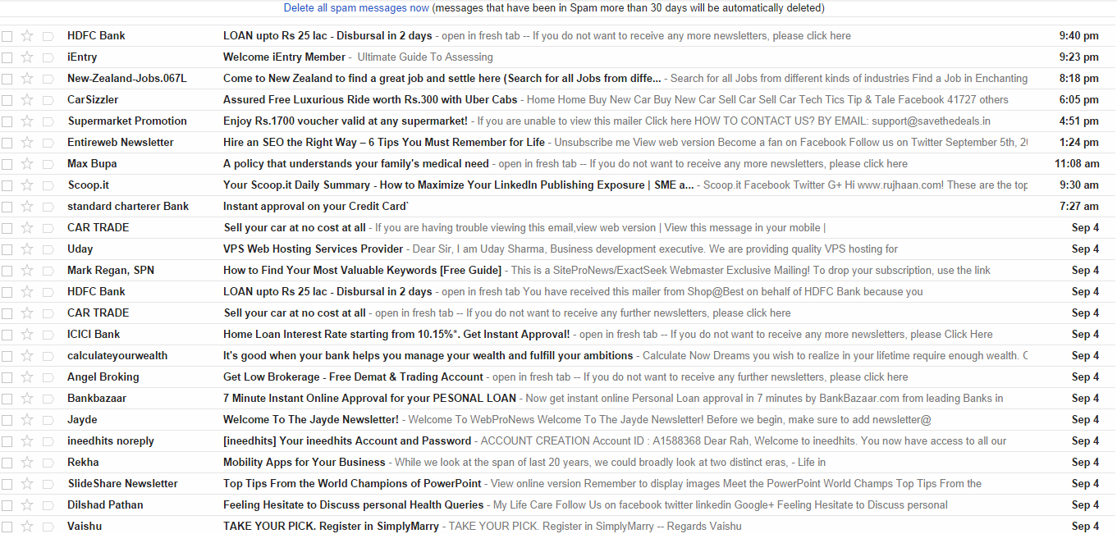
it’s not (Snapshot of Spam folder)
Not a Spam
Not a Spam

Slide 12
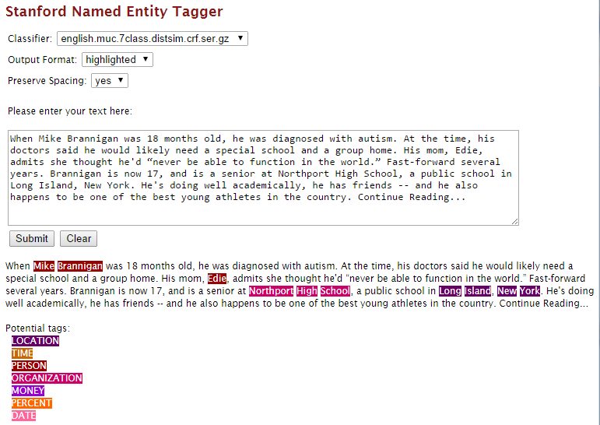
NER (Named Entity Recognition)

Slide 13
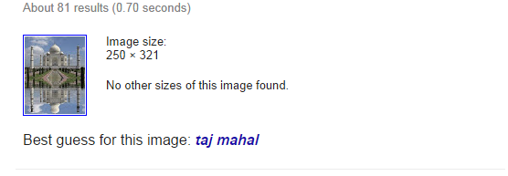
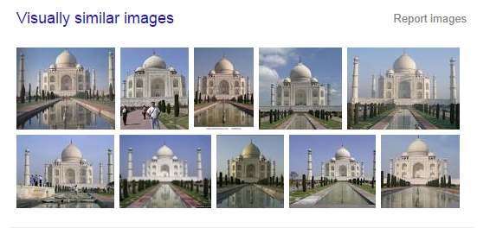
Similar/Duplicate Images
Remember
Features ?
(Feature Extraction)
Can be :
Width
Height
Contrast
Brightness
Position
Hue
Colors

Slide 14
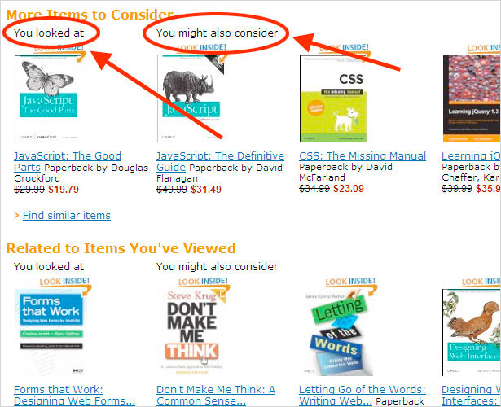
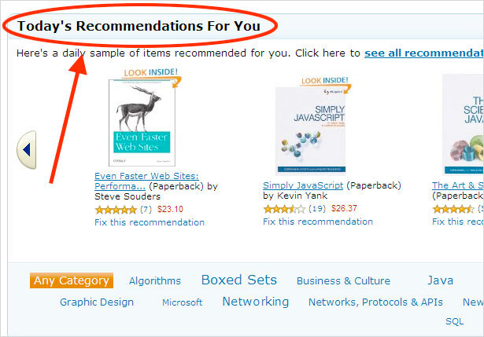
Recommendations
http://www.webdesignerdepot.com/2009/10/an-analysis-of-the-amazon-shopping-experience/

Slide 15
The concept of learning in a ML system
Learning = Improving with experience at some task
Improve over task T,
With respect to performance measure, P
Based on experience, E.

Slide 16
Terminology
Features
The number of features or distinct traits that can be used to describe each item in a quantitative manner.
Samples
A sample is an item to process (e.g. classify). It can be a document, a picture, a sound, a video, a row in database or CSV file, or whatever you can describe with a fixed set of quantitative traits.
Feature vector
is an n-dimensional vector of numerical features that represent some object.
Feature extraction
Preparation of feature vector
transforms the data in the high-dimensional space to a space of fewer dimensions.
Training/Evolution set
Set of data to discover potentially predictive relationships.

Slide 17
Let’s dig deep into it…
What do you mean by
Apple?

Slide 18
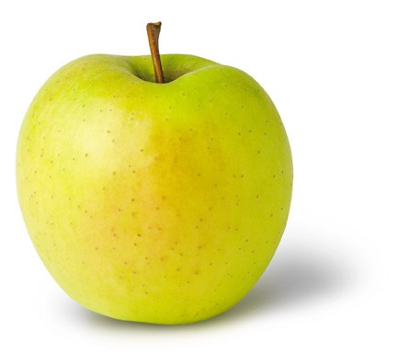
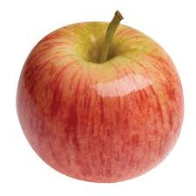

Learning (Training)
Features:
1. Color: Radish/Red
2. Type : Fruit
3. Shape
etc…
Features:
1. Sky Blue
2. Logo
3. Shape
etc…
Features:
1. Yellow
2. Fruit
3. Shape
etc…

Slide 19
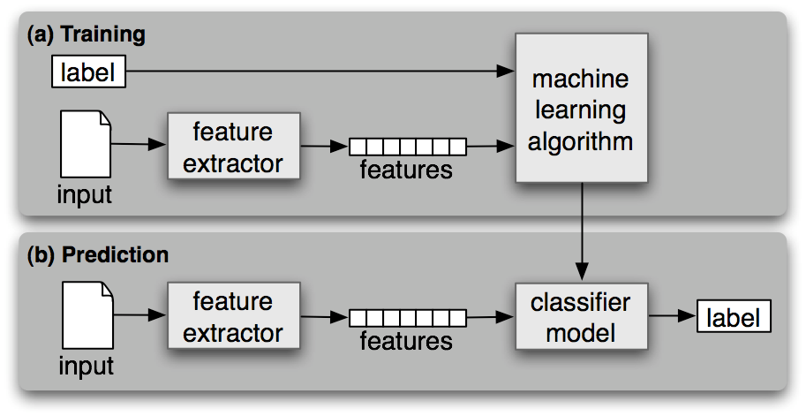
Workflow

Slide 20
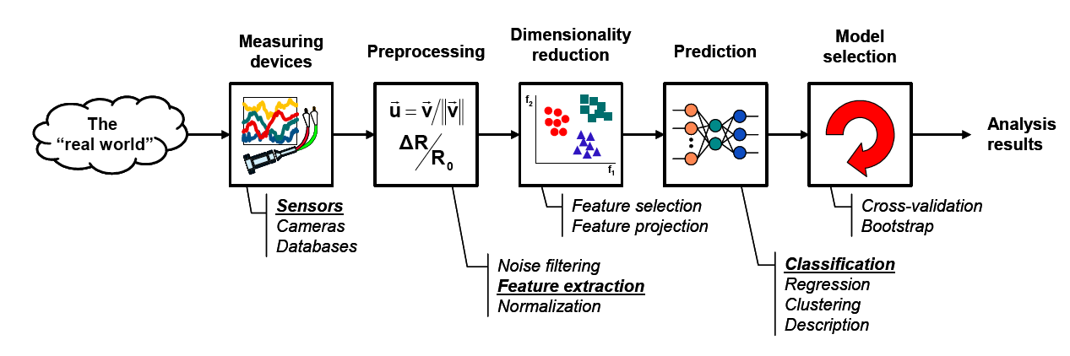
The Learning Process

Slide 21
Categories
Supervised Learning
Unsupervised Learning
Semi-Supervised Learning
Reinforcement Learning

Slide 22
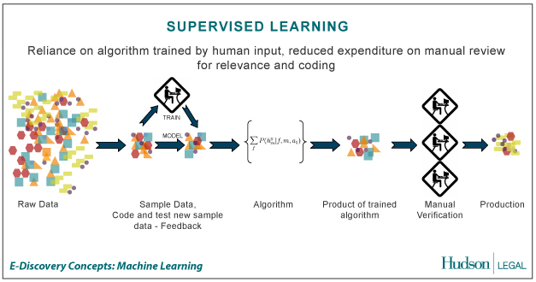
Supervised Learning
the correct classes of the training data are known

Slide 23
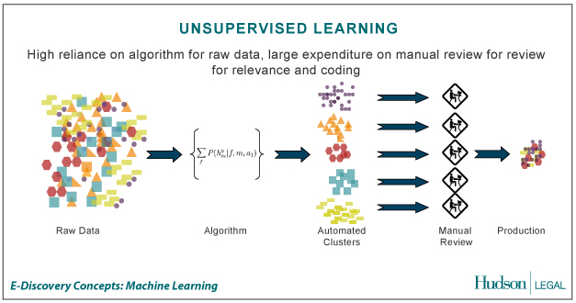
Unsupervised Learning
the correct classes of the training data are not known

Slide 24
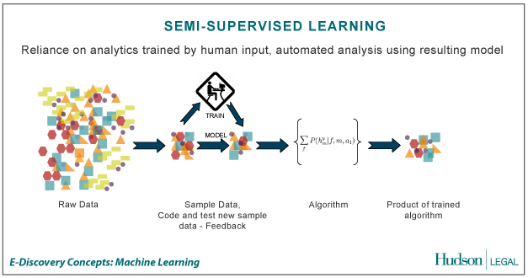
Semi-Supervised Learning
A Mix of Supervised and Unsupervised learning

Slide 25
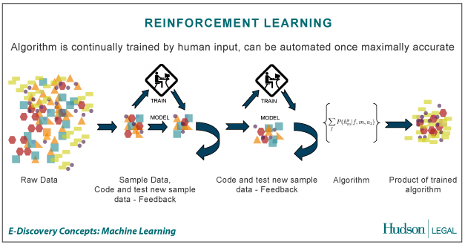
Reinforcement Learning
allows the machine or software agent to learn its behavior based on feedback from the environment.
This behavior can be learnt once and for all, or keep on adapting as time goes by.

Slide 26
Machine Learning Techniques

Slide 27
Techniques
classification: predict class from observations
clustering: group observations into “meaningful” groups
regression (prediction): predict value from observations

Slide 28
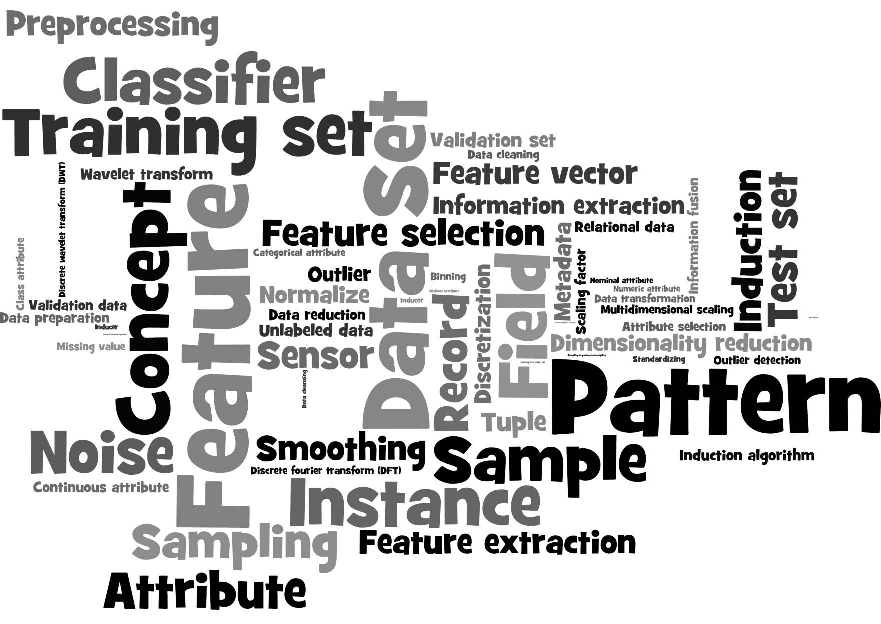

Slide 29
Popular Frameworks/Tools
Weka
Carrot2
Gate
OpenNLP
LingPipe
Stanford NLP
Mallet – Topic Modelling
Gensim – Topic Modelling (Python)
Apache Mahout
MLib – Apache Spark
scikit-learn - Python
LIBSVM : Support Vector Machines
and many more…

Slide 30
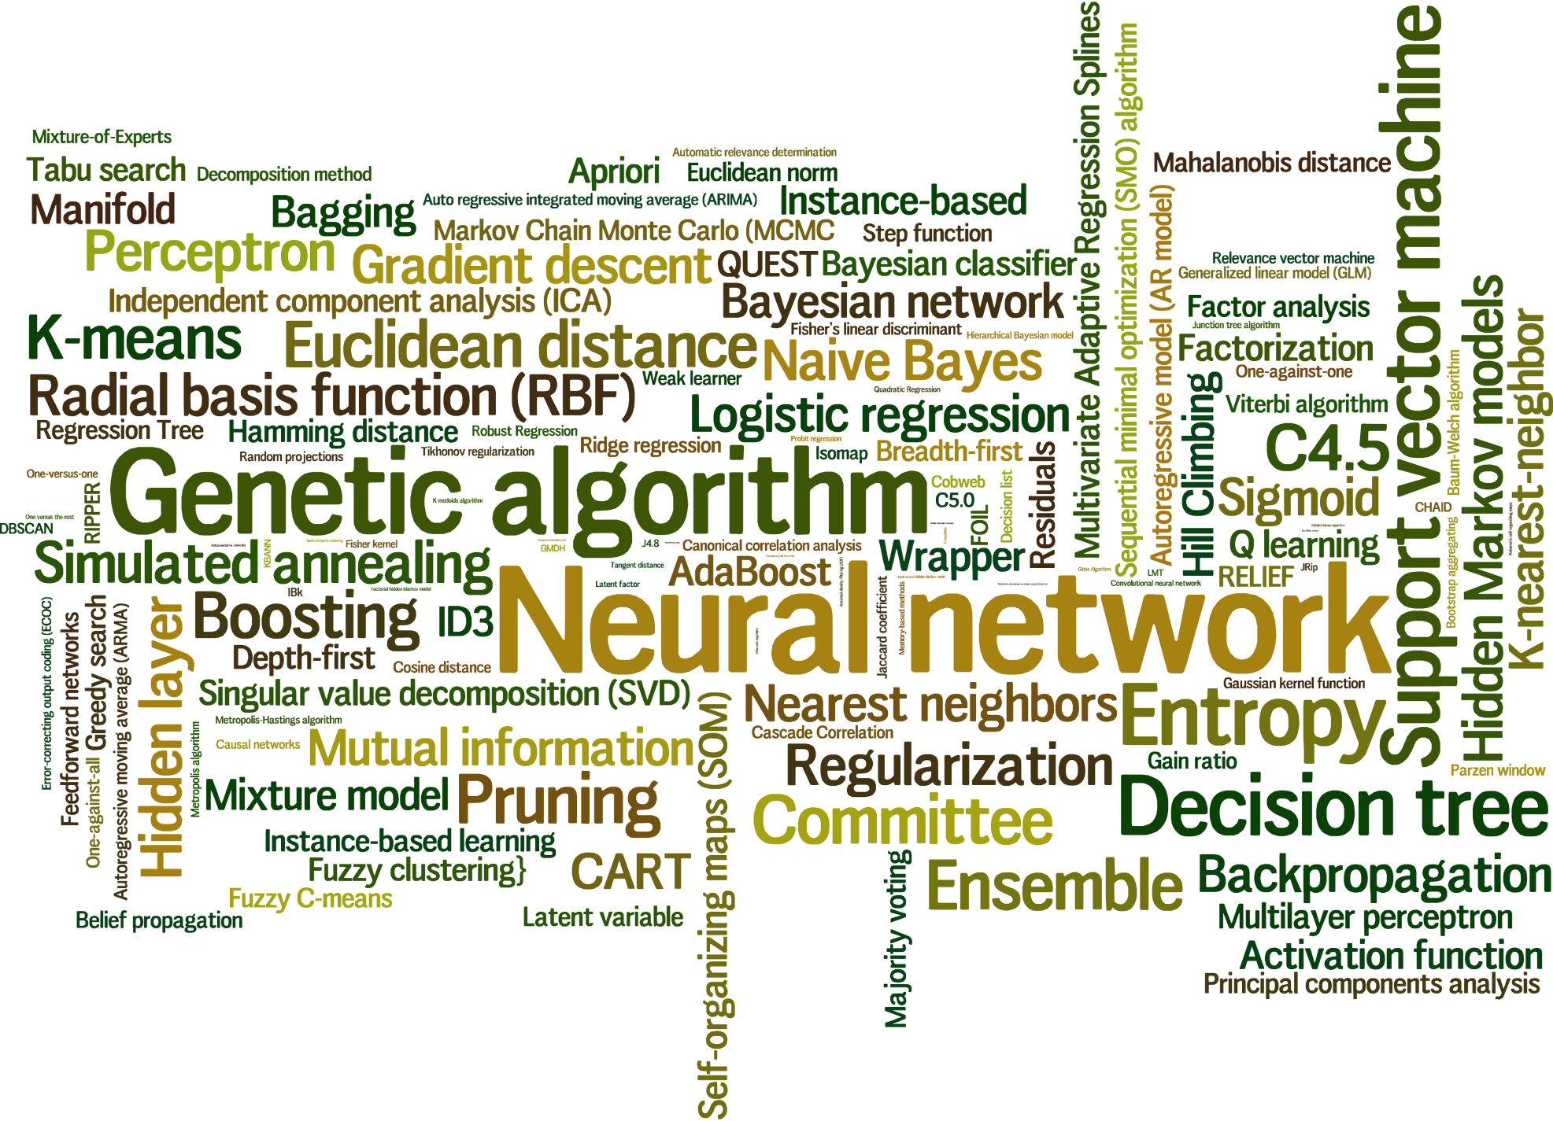
Learning Algorithms

Slide 31
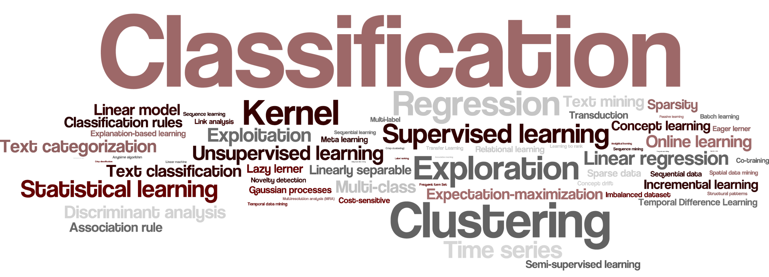
Learning Tasks

Slide 32
Questions?

Slide 33
Thanks!

